Slide 1

Human resource, payroll , leave and performance management platform
CSA0918 – Programming in Java
Guided by :
Dr . Padmakala S
Presented by :
Tamil Elakiya S (192524443)
Rommala Varshini (192525349)

Slide 2



Agenda
Abstract
Introduction & Project Overview
Problem Statement & Gaps in Existing Systems
Objectives & Proposed Solution System Architecture
Module Breakdown (HR, Payroll, Leave, Performance)
System Integration & Flow (Java Backend Architecture)
Expected Results & Evaluation Plan

Slide 3


Abstract
Background: Organizations frequently struggle with fragmented administrative systems where HR, payroll processing, leave tracking, and employee performance evaluations operate in silos.
Core Idea: A unified, secure, web-based platform built on Java technology to automate workforce management workflows end-to-end.
Key Features: Automated salary slip generation, real-time leave balance calculations, KPI-based performance tracking, and role-based access control (RBAC) for Admin, HR, Managers, and Employees.
Impact: Eliminates manual record-keeping errors, streamlines approval chains, and improves data accuracy across department functions.

Slide 4
Introduction
Workforce management requires seamless integration between employee databases and financial operations.
Digital transformation in internal operations enhances administrative efficiency and reduces overhead costs.
Why Java?
High enterprise reliability, security, and scalability.
Robust ecosystem for backend operations (Spring Security, Spring Data JPA).
Seamless database connectivity via JDBC/Hibernate.

Slide 5
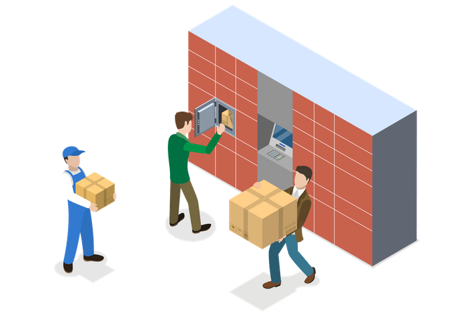
Problem Identification and Analysis
Manual Data Handling: Reliance on spread-sheets leads to duplicate records and human errors during payroll calculation.
Delayed Approvals: Paper-based or unintegrated email workflows slow down leave requests and performance reviews.
Lack of Analytics: Difficulty in correlating leave trends or performance scores directly with payroll and incentives.
Security & Access Risks: Unsecured data channels present confidentiality risks regarding salary structures and personal data.

Slide 6
Objectives
To design and build a secure, web-based platform using Java architecture that unifies core HR, leave management, payroll, and performance tracking into a single system.
To centralize employee data management by creating a secure relational database for profiles, department details, and organizational roles.
To automate leave request and approval workflows with real-time balance calculations, automated deductions, and manager notifications.
To calculate gross and net salaries automatically in Java by integrating basic pay, tax deductions, allowances, and Loss of Pay (LOP) derived from leave data.
To generate dynamic monthly PDF pay-slips for employees automatically using Java PDF generation libraries.

Slide 7
Solution Design
Proposed Architecture: Model-View-Controller (MVC) Pattern.
Backend: Java (Spring Boot REST APIs / Servlets) for enterprise business logic.
Database Layer: MySQL/PostgreSQL integrated via Spring Data JPA / Hibernate.
Frontend: HTML5, CSS3, JavaScript, Bootstrap (or Thymeleaf/React integration).
Security Layer: Role-Based Access Control (RBAC) with BCrypt password encryption to isolate HR, Manager, and Employee privileges.

Slide 8
Module 1 : HR & Leave Management
HR Core Module:
Centralized employee profile management (Onboarding, Personal Info, Designation, Department).
Unique Employee ID generation and dynamic status tracking (Active, Resigned, On-Leave).
Leave Management System:
Request submission portal for employees (Paid Leave, Sick Leave, Casual Leave).
Dynamic leave quota tracking and automatic deductions upon HR/Manager approval.
Real-time leave calendar and notification triggers.

Slide 9
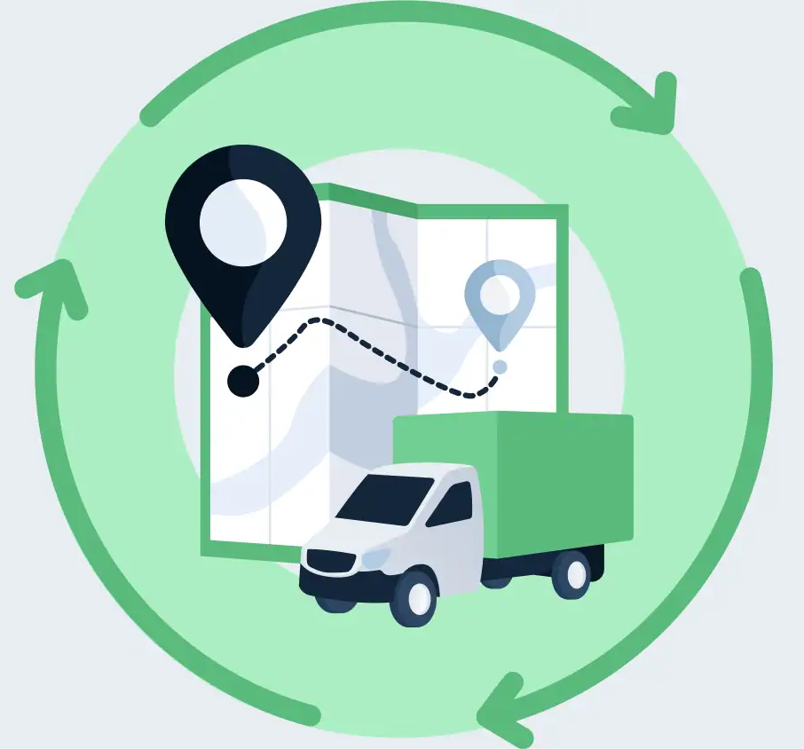
Module 2 :Payroll & Performance Tracking
Payroll Processing Engine:
Automated gross and net salary calculation based on basic pay, allowances, tax deductions, and unpaid leave days.
PDF pay-slip generation via Java PDF libraries (e.g., iText or JasperReports).
Performance Evaluation Module:
Quarterly/Annual KPI ratings, Manager feedback submissions, and self-appraisal portals.
Rating-based incentive mapping directly into the payroll engine.

Slide 10
Integration of Modules
Inter-Module Connectivity:
Leave module feeds into the Payroll engine to calculate Unpaid Leaves / Loss of Pay (LOP).
Performance ratings feed into annual appraisal/bonus calculations within the Payroll engine.
Database Relational Design:
Centralized relational tables linked via foreign key constraints (employee_id, leave_id, payroll_id, review_id).

Slide 11
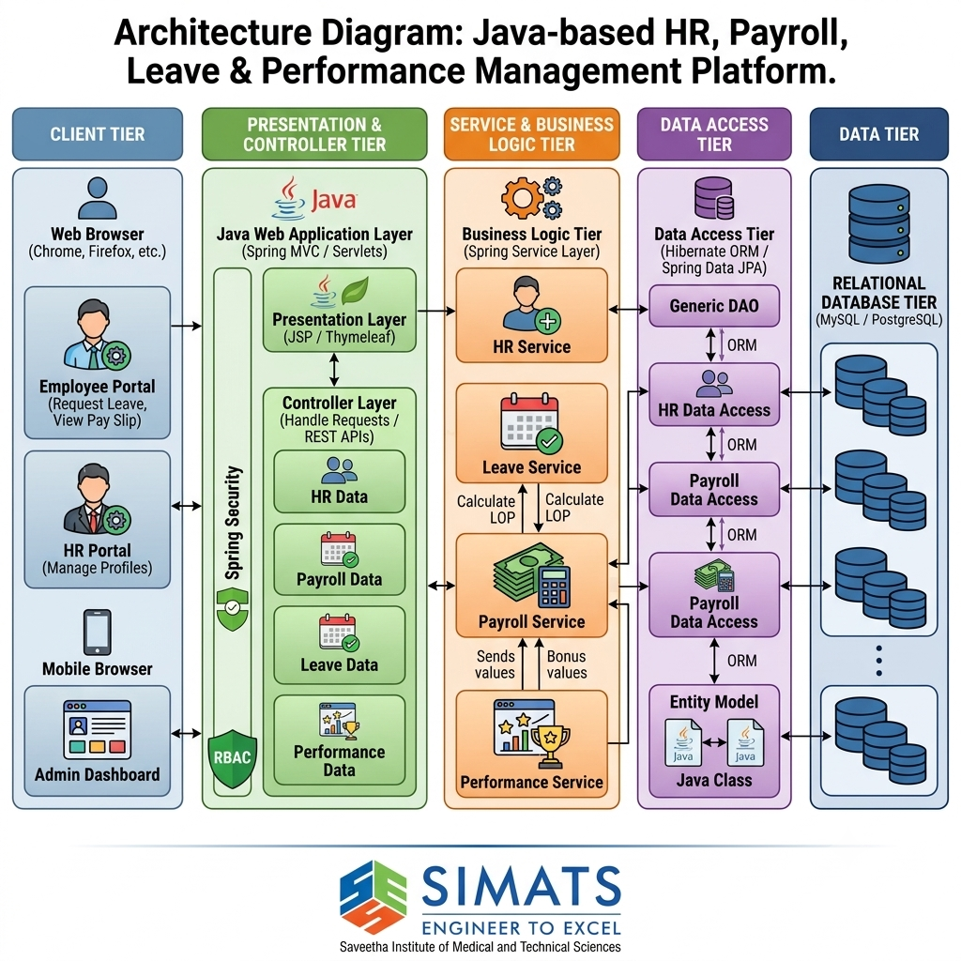
Architecture Diagram

Slide 12
Result and Discussion
Automated Calculations: Zero manual error in monthly payroll processing and leave balance adjustments.
Faster Request Processing: Instant routing of leave and appraisal requests to respective managers.
Enhanced Data Security: Strict data isolation so employees can only access their own pay-slips and leave records.
Centralized Reporting: HR dashboard providing real-time headcount, attendance summaries, and performance distributions.

Slide 13
Conclusion
Successfully conceptualized a unified, secure Java-based platform to automate core HR, leave, payroll, and performance operations.
Developed a robust 3-tier MVC software architecture integrated with Role-Based Access Control (RBAC) to ensure data confidentiality and integrity.
Designed dynamic inter-module logic to eliminate manual data entry, human calculation errors, and administrative delays.
Established a solid architectural baseline for Phase 2 development, focusing on database schema deployment, REST API integration, and user interface implementation.

Slide 14


